Slide 1

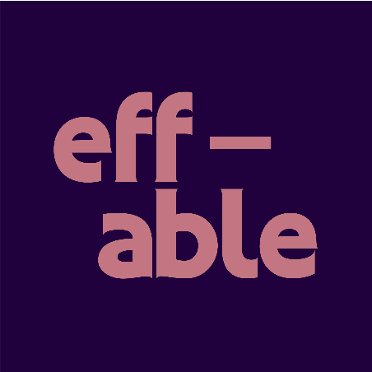
eff-able
eff-able
Queer Disabled Joy!
SUNDAY ASSEMBLY
PRIDE SPECIAL
JP Seabright & George Violet Parker
Notes:
Good morning!
Today, in the afterglow of Pride shenanigans, I want to talk about queer disabled joy. And poetry. And how these two things, which may appear to be unlikely bedfellows, came together in an explosion of creativity during our eff-able project.
So called, because eff-able means something that is capable of being uttered or expressed – the words and voices of our queer disabled, chronically ill, Deaf, and neurodivergent community raised loud in anger and joy – and effable as in, well, effable.

Slide 2
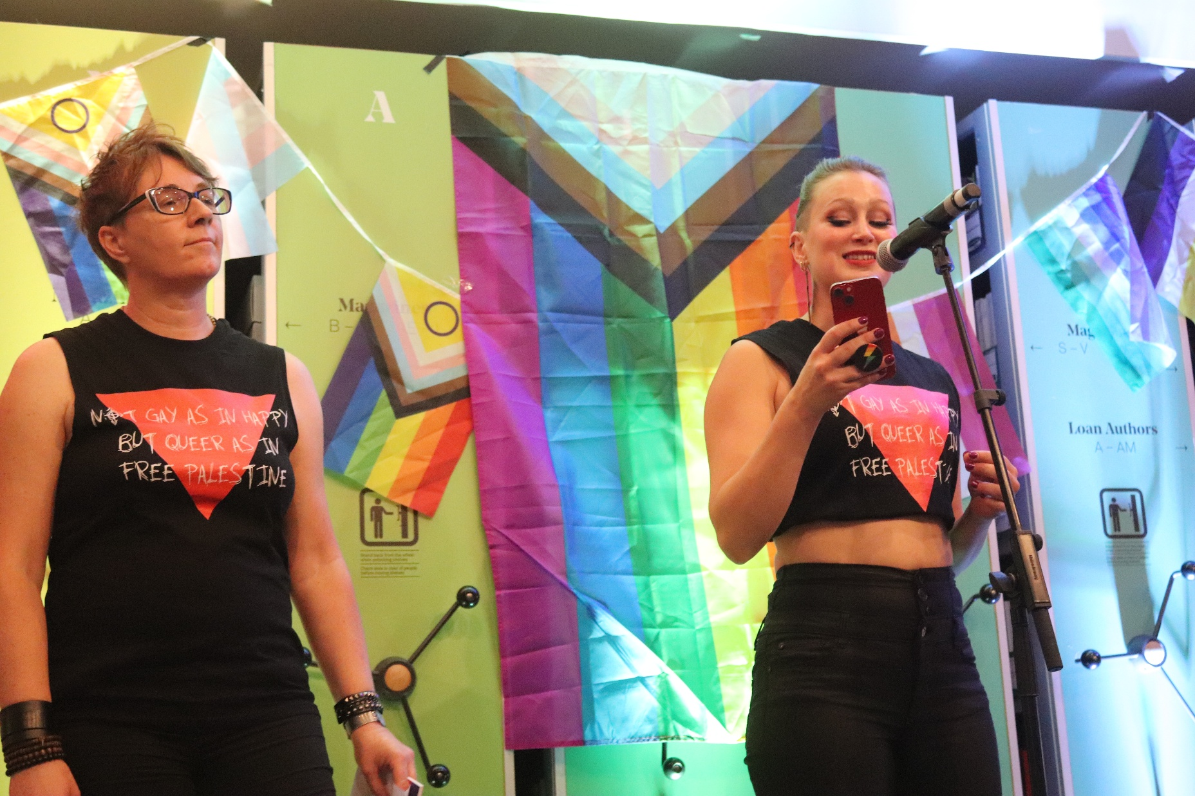
Desire lines
Where are we?
Our lives, bodies, and desires?
“eff-able has meant being finally, in community with more people that are non-binary, trans, queer as well as disabled, chronically ill, and neurodivergent. Rarely do we ever have community spaces that are accessible and open, and embracing all our identities.”
Notes:
So, what is eff-able?
The project began over two years ago with the simple but quietly outrageous question: where were we? On the page and on the stage.
Where was the work that reflected our lives? Where was the poetry that let queer disabled people be desired and desiring, be seductive, erotic, funny, political, angry, outrageous, and human?
George and I wanted to write, and to read, about intimacy, embodiment, fantasy, and the reality of physical desire for a bodywonky, neurospicy person. To see ourselves, and to read an honest and accurate portrayal of pleasure, in poetry.
But it didn’t exist. Not one anthology that we could find. So naturally we decided we had to make one.

Slide 3
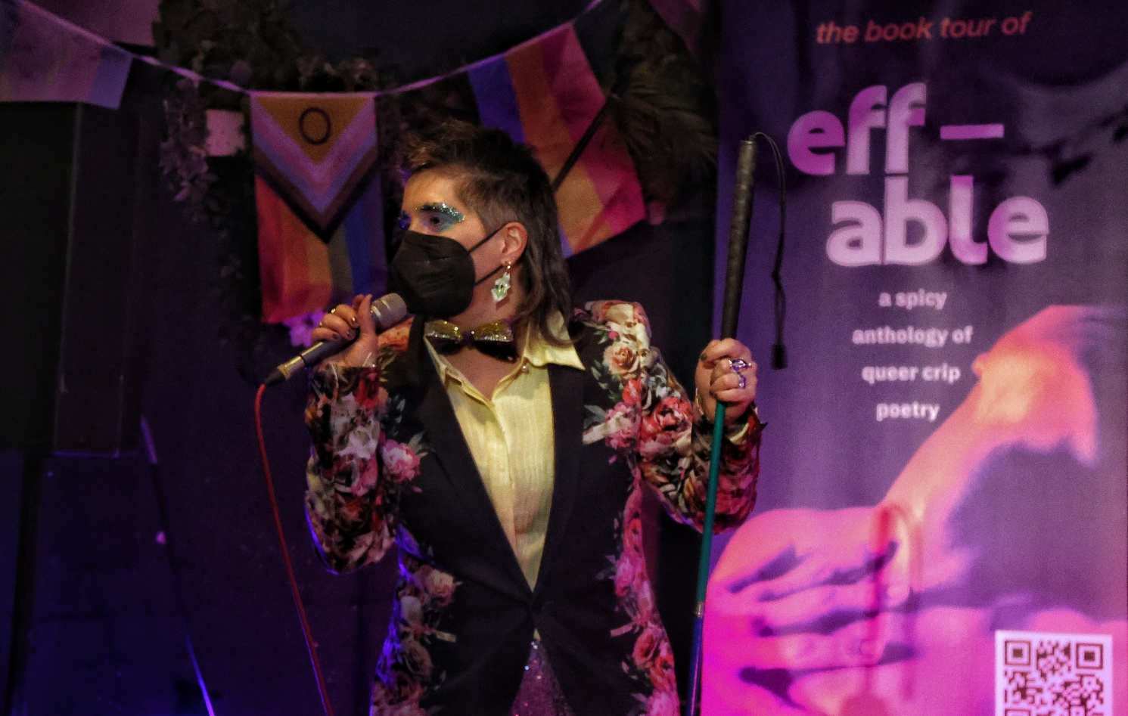
Build it and they will come
An anthology
A live project
A rallying cry
Poetry that gives space to intimacy, tenderness, embodiment & pleasure
We are not waiting politely to be invited in:
we’re already here
Workshops, performance and touring activity that created connection beyond the page
Notes:
eff-able became more than an idea. It became an anthology, a live project, a roadshow, and a community.
It was a way of saying: we are not waiting politely to be invited in. We are already here, we are effing gorgeous, and we’re making something beautiful. This was never just about producing a book, it was about building visibility, connection, and joy around queer crip creativity.

Slide 4
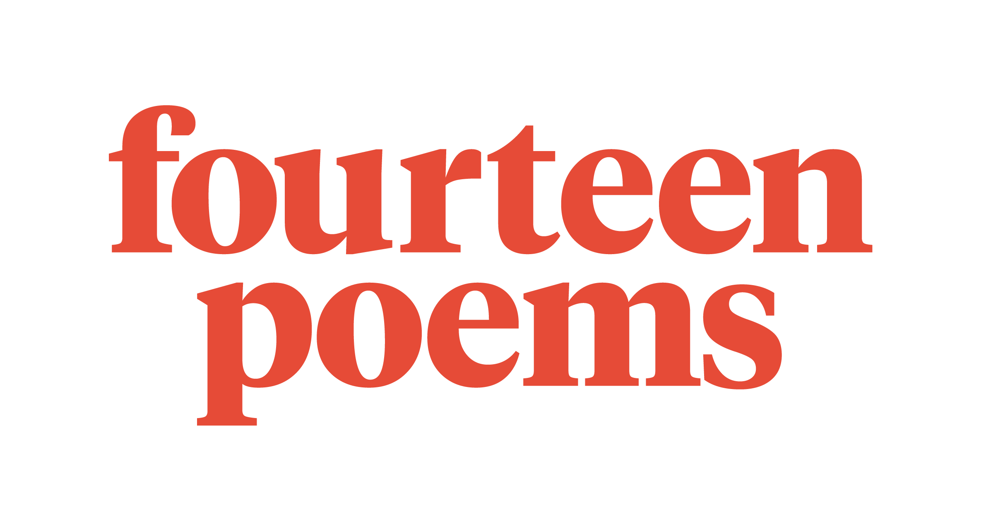

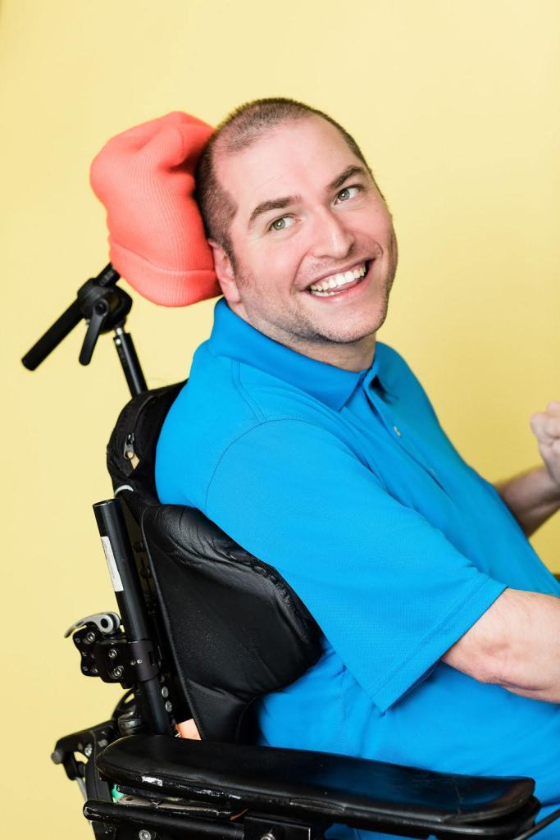
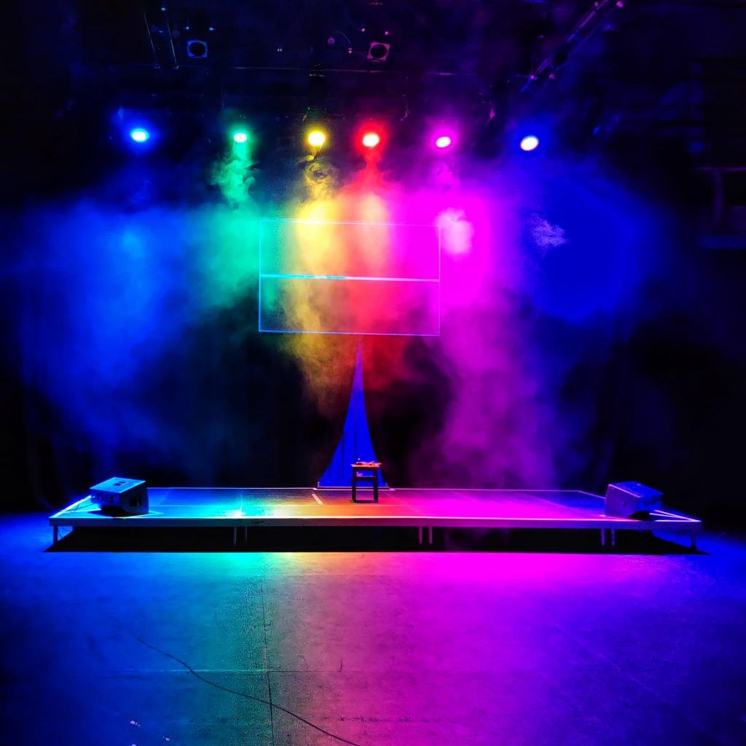
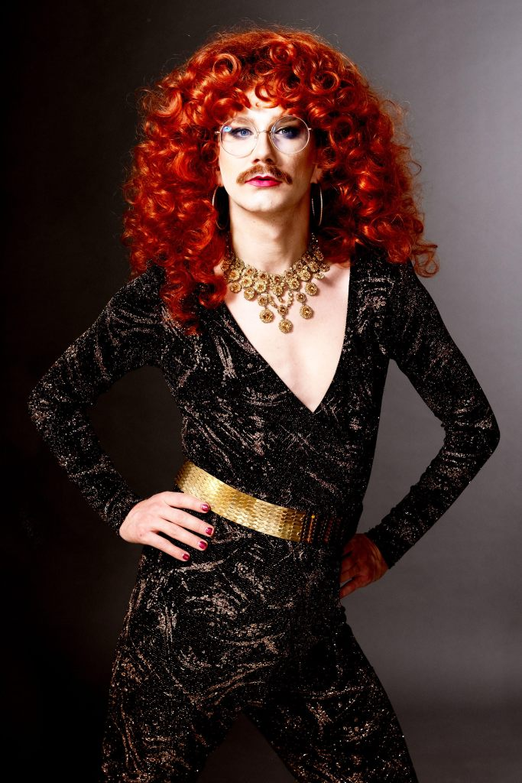
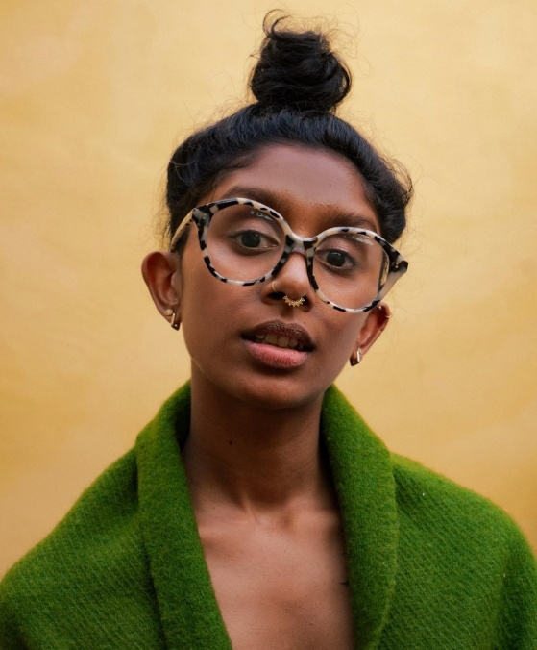
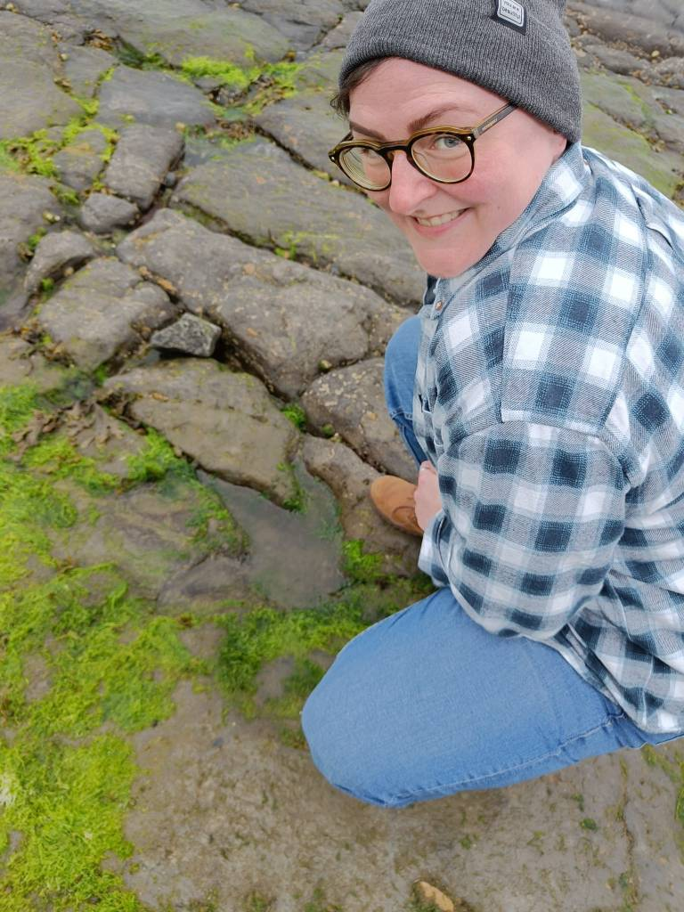
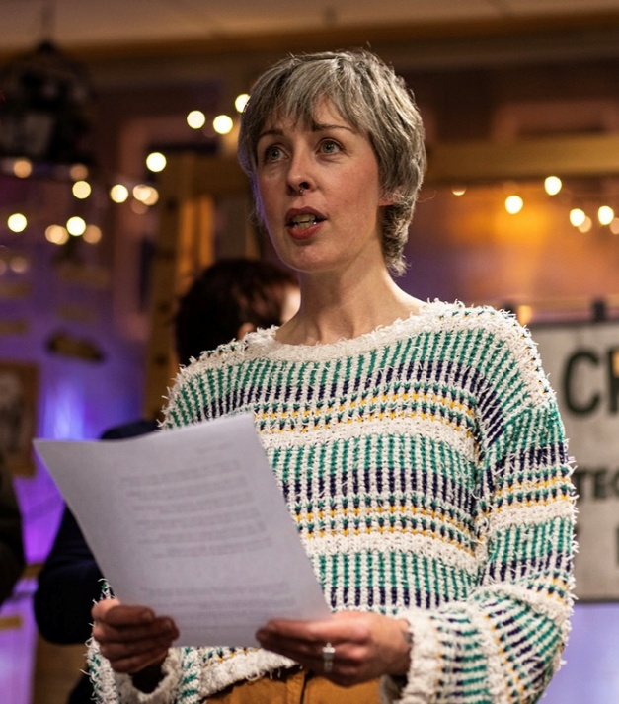
Finding the perfect partner(s)
funder
publisher
performance & accessibility advisors
mentors & facilitators
Quiplash
Notes:
Once we knew what we wanted to make, the next question was: who could help us make it?
We needed the right partners, not just people who could ‘do stuff’, but people who understood the politics, and who ‘got’ the vision.
The project worked well because it was inherently collaborative in nature, and we wanted to get insights and expertise from our crip queeroes – and thanks to a grant from ACE we could pay them for their input!

Slide 5
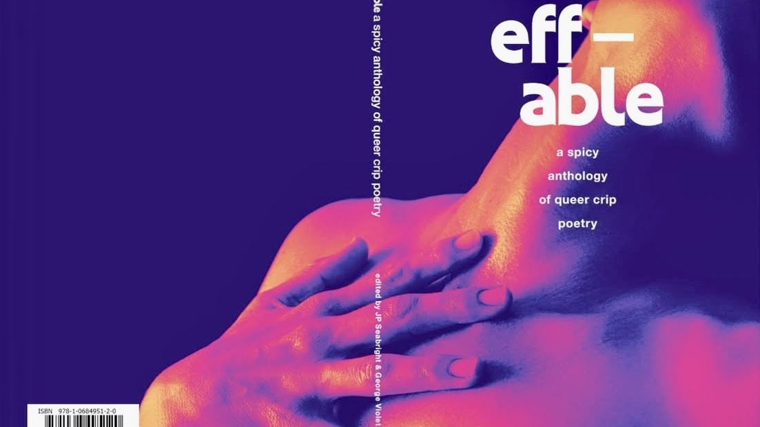
Notes:
And here she is…

Slide 6
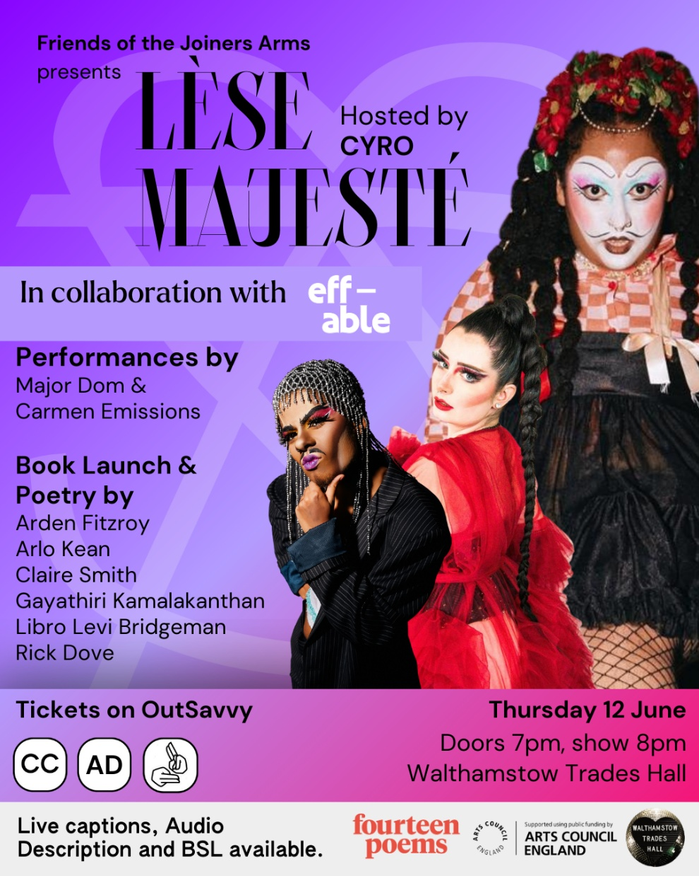
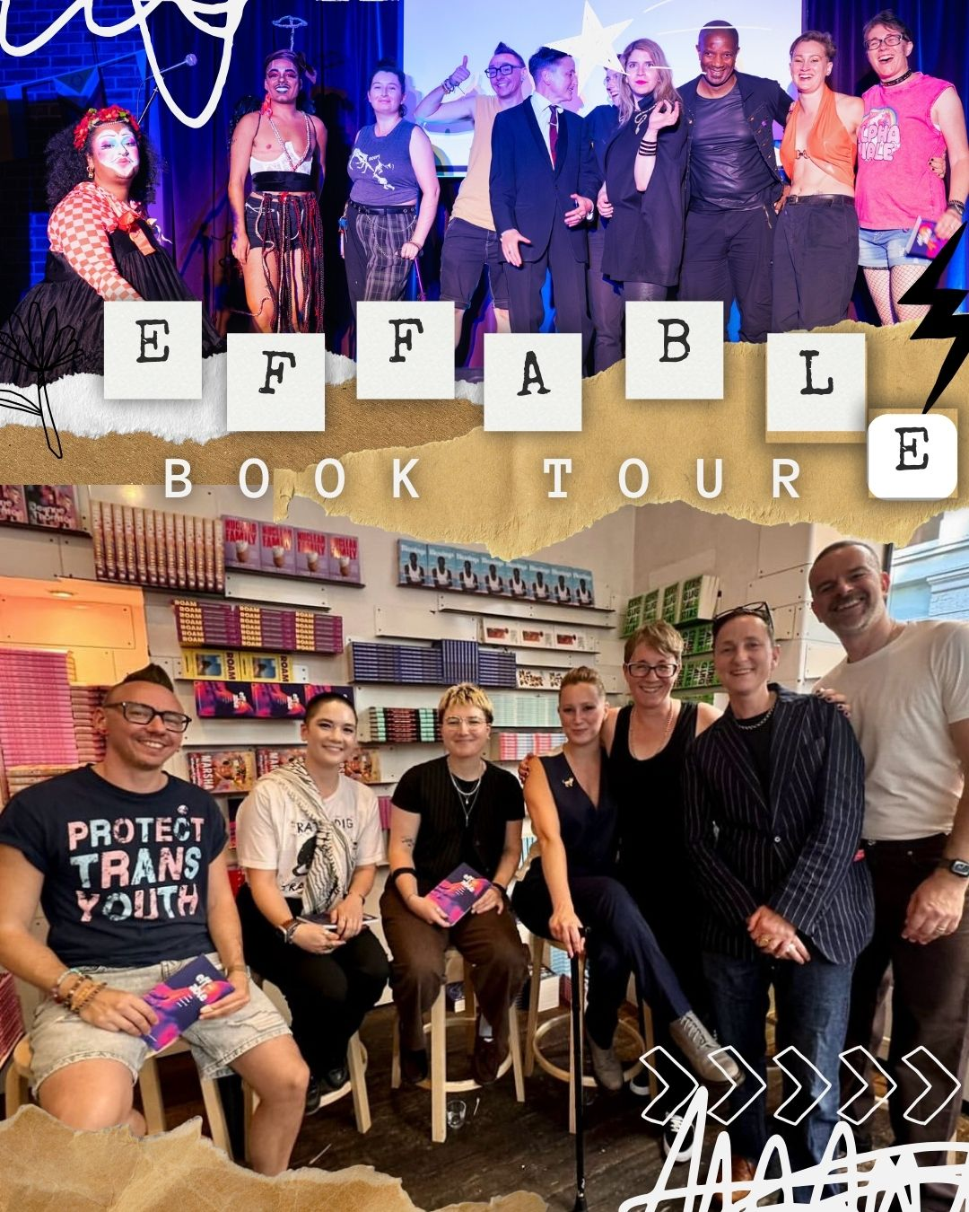
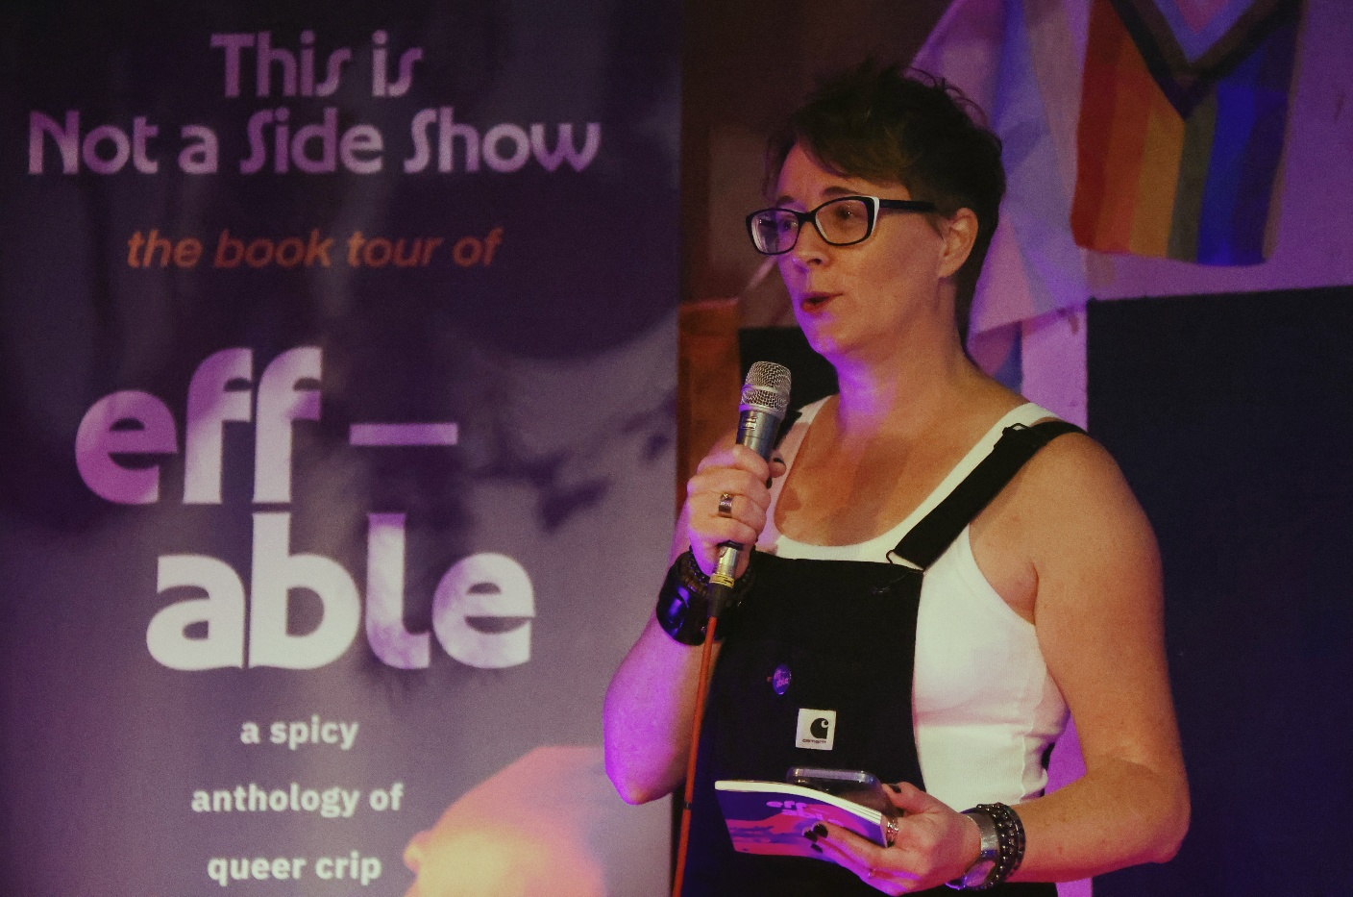
We are not a sideshow
Access is not admin. Access is creative practice. Access is politics.
Access is how you say: you belong here.
Notes:
But from the outset eff-able was always more than a poetry anthology – we wanted to bring queer disabled joy to the stage as well as the page.
One of the things we are proudest of is that access was part of the ambition from the start, not an afterthought.
That meant free workshops, large print copies, BSL interpretation, audio description, and a commitment to using queer venues that were actually accessible.

Slide 7
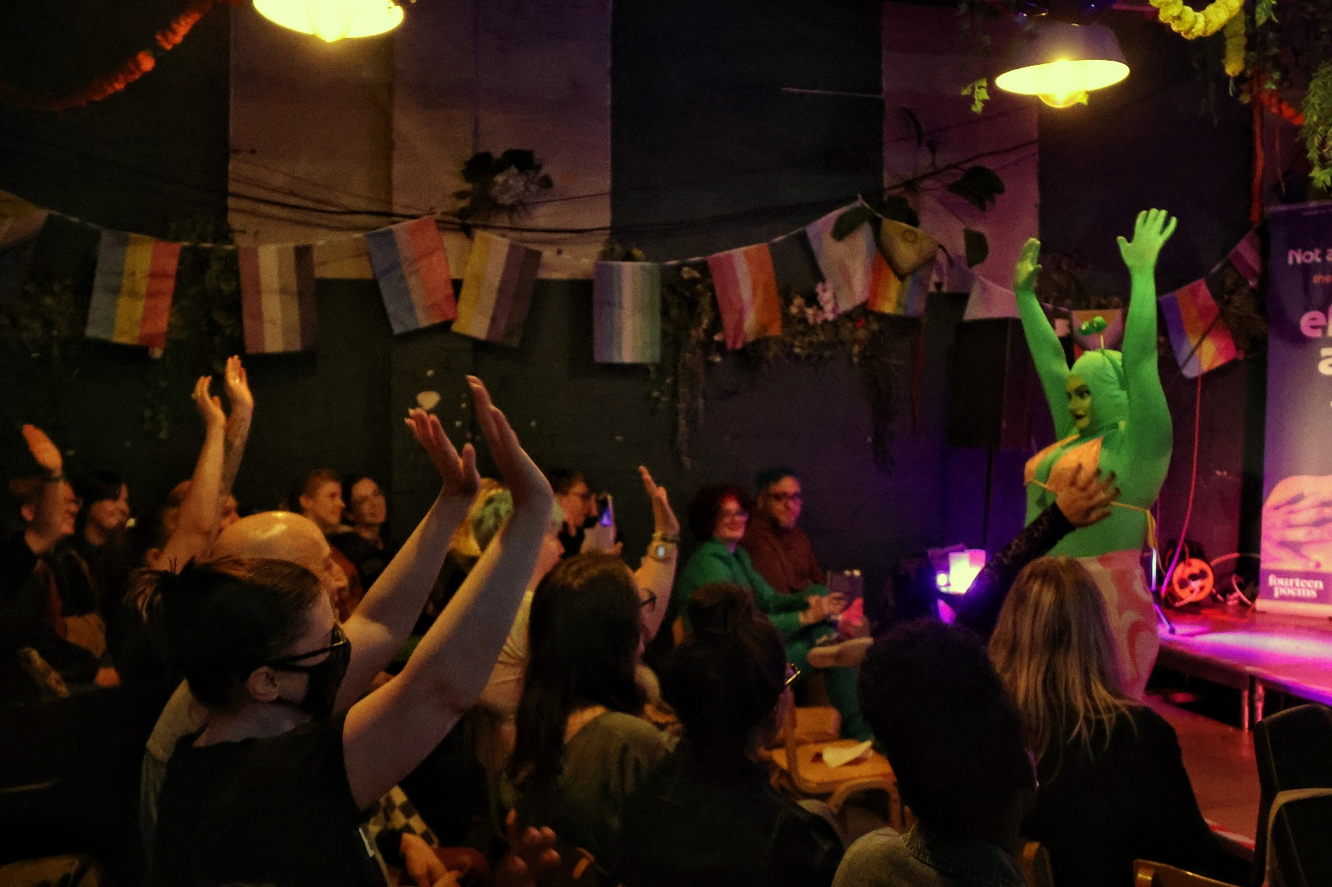
Why it matters
Art matters
Activism matters
Representation shapes
possibility
◉
∞
Art can challenge social ‘norms’ & beliefs – that disabled people are passive, undesirable or outside culture
Access, desire & pleasure are not extras — they are part of who we are and how we claim space
When queer disabled lives are visible, people can imagine more for themselves and each other
Notes:
This matters beyond one book or one mini roadshow.
We wanted eff-able to push back against the old stories that frame disabled people as passive, undesirable, or outside culture.
The anthology and the events we’ve held says something far more truthful, and far more powerful - queer disabled lives are here, making work, making noise, making joy, and claiming space.
We are not marginal to culture. We are culture.

Slide 8
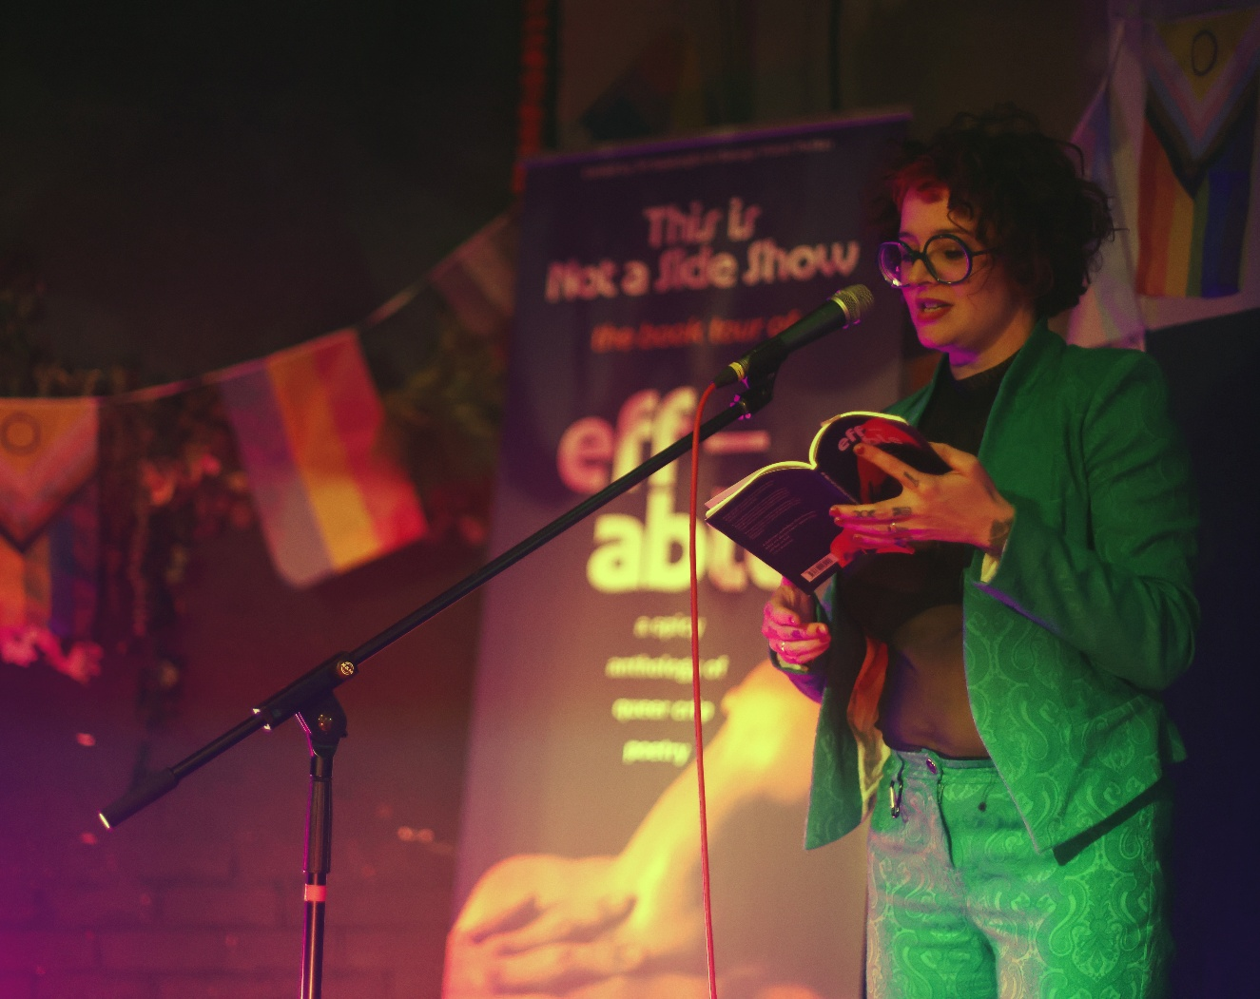
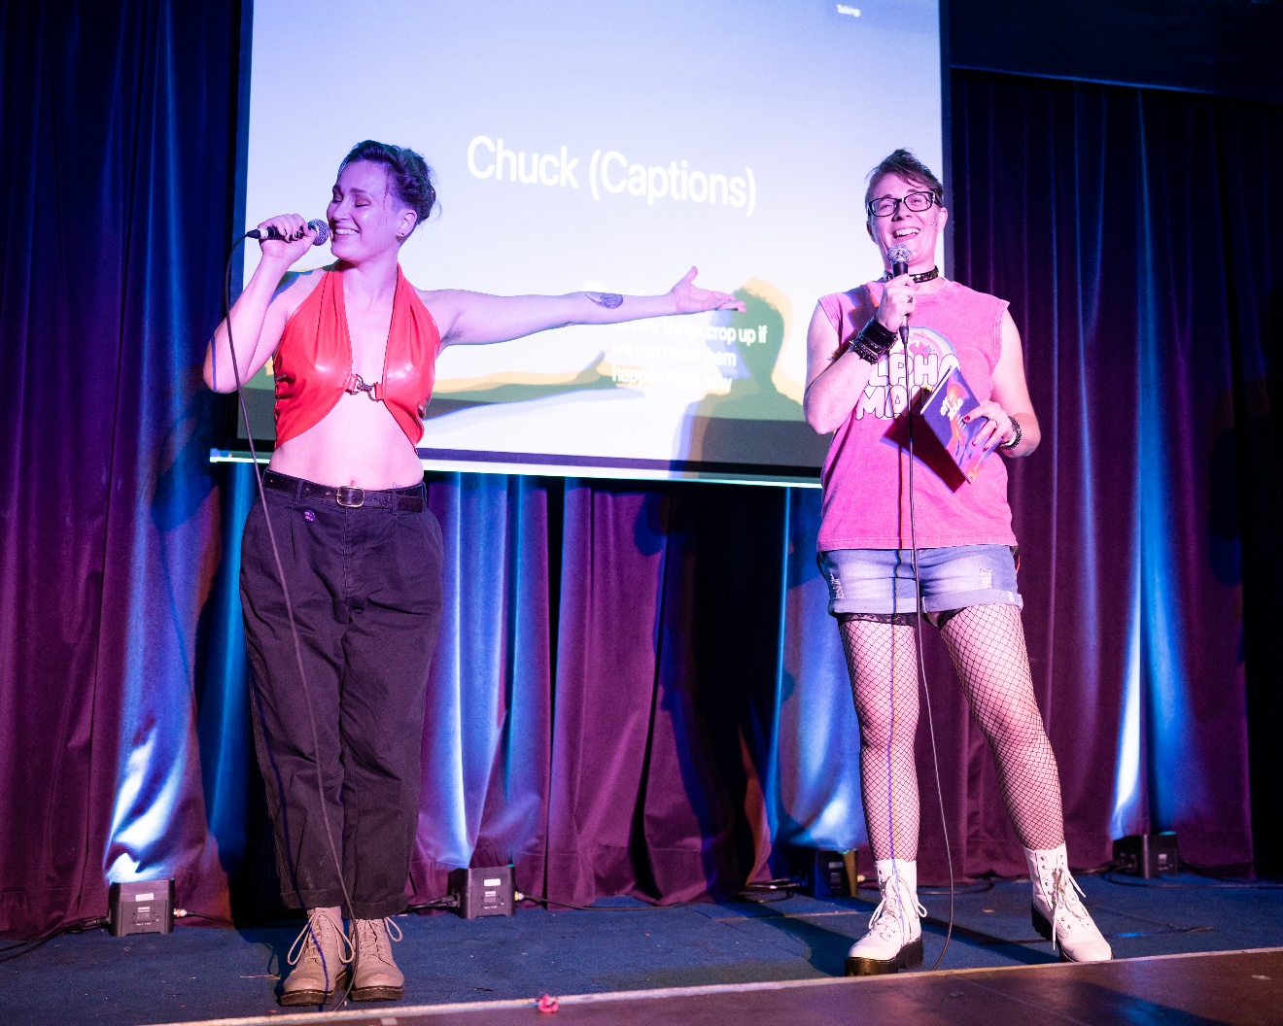
What we picked up along the way
Harder on the inside
Community was ready
Access makes it better
It was hard work.
But the effort, and risk, was worth it.
Building for access from the start made the poetry and performances bolder, sharper and more alive.
It felt like a gamble, but people showed up.
Artists and audiences were already there, waiting for this.
“What I really love about eff-able is its celebration of those bodies that have been put in boxes and said no. These bodies are capable of so much more. ”
Notes:
It was hard work – far more effort than I think either of us imagined.
Also, when we first conceived of eff-able and submitted our application, I was working part-time, George also had more time and flexibility. By the time our ACE app was approved, and we opened the submission process, I had a busy full-time job, and George had challenging family commitments to deal with.
But we found a way, we adapted, we allowed for crip time (as much as possible) we shared the workload in the way that worked best for us both, and we remained friends…
Luckily, for a poetry anthology that sought to find and spotlight a specific community – that community showed up! To buy copies, to attend events, to perform, and support and be there for us, in ways we could not have identified in a funding application.
eff-able taught us that things that are hard are worth doing, risk in art and writing, is worth it. There were challenging times – finding venues, trying to promote events when it’s just us doing it in our spare times, and the social medial algorithms are not on your side - but people showed up because the community was already there and artists were already doing this work.
We also demonstrated, in a way that even surprised us at times, that if you build for access from the start, you don’t shrink the art. You make it bolder, sharper, more vibrant – and at times more funny, more political, more [sexy], more radical and outrageous.

Slide 9
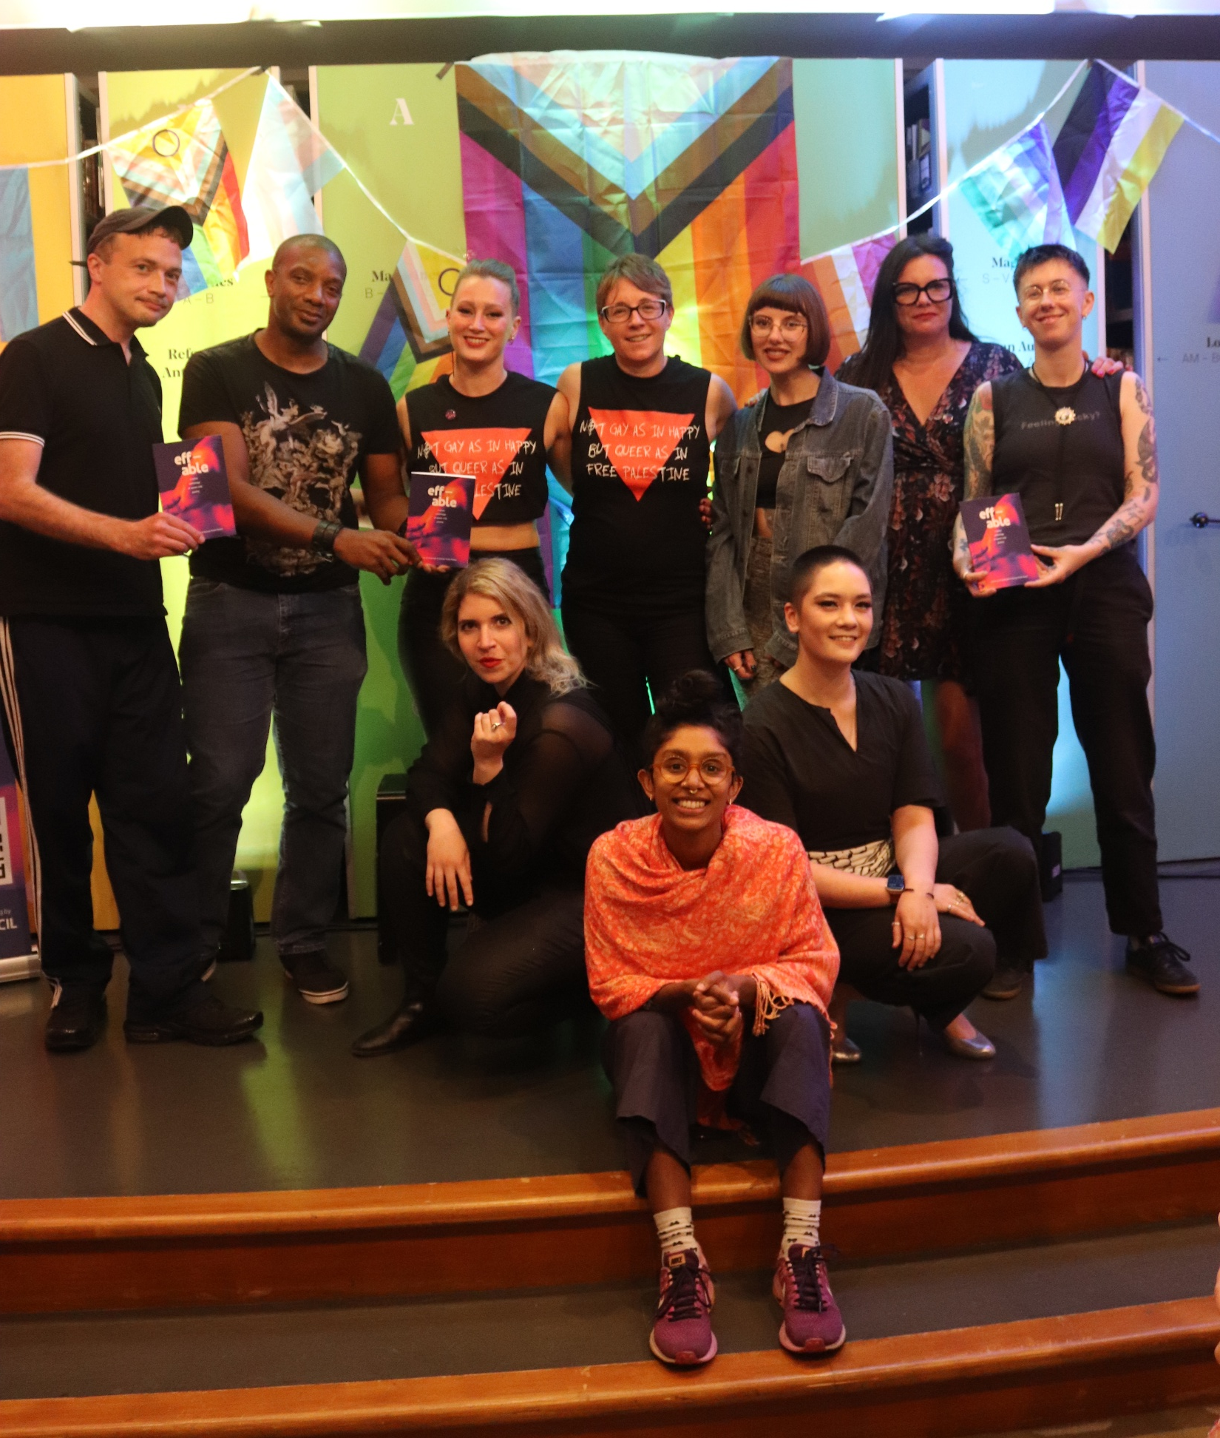
Coming together
39 poets published
31 live poets + 18 online
12 cabaret & drag artists
7 venues
2nd print run
500+ books sold
“It’s been incredibly validating and special
for queer disabled people to read this work and have a platform.”
Notes:
We love it when a plan comes together.
A vision, a community, the joy of expression, of celebrating others – some seeing themselves in print and on the stage for the first time.
Here are the numbers.
We published 39 poets, platformed 31 poets live and another 18 online, and worked with 12 cabaret and drag artists across 7 venues. The anthology is into its second print run and we’ve sold more than 500 copies.
This project travelled, reached people, and made real noise.

Slide 10
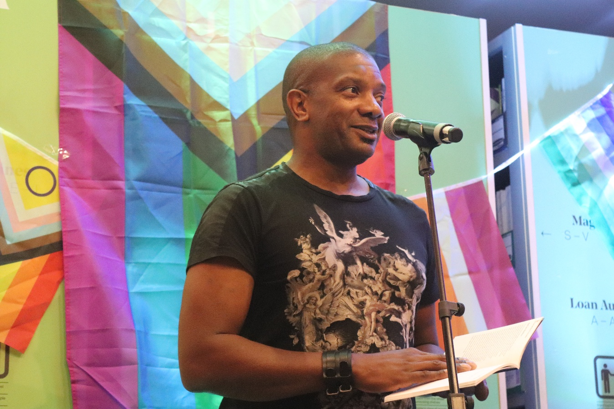
Give the people their flowers
Audiences
Poets
Workshop Facilitators
Funder
Readers
Performers
Publisher
Stage
crew
BSL
interpreters
Notes:
So now comes the best bit: saying a big public thank you.
Thank you to the poets, performers, publisher, typesetter, designer, workshop facilitators, interpreters, audio describers, closed caption video projectors, funders, stage managers, collaborators, audiences, and supporters.
Thank you to everyone who made space, solved problems, carried things, backed things, and believed in this project.

Slide 11
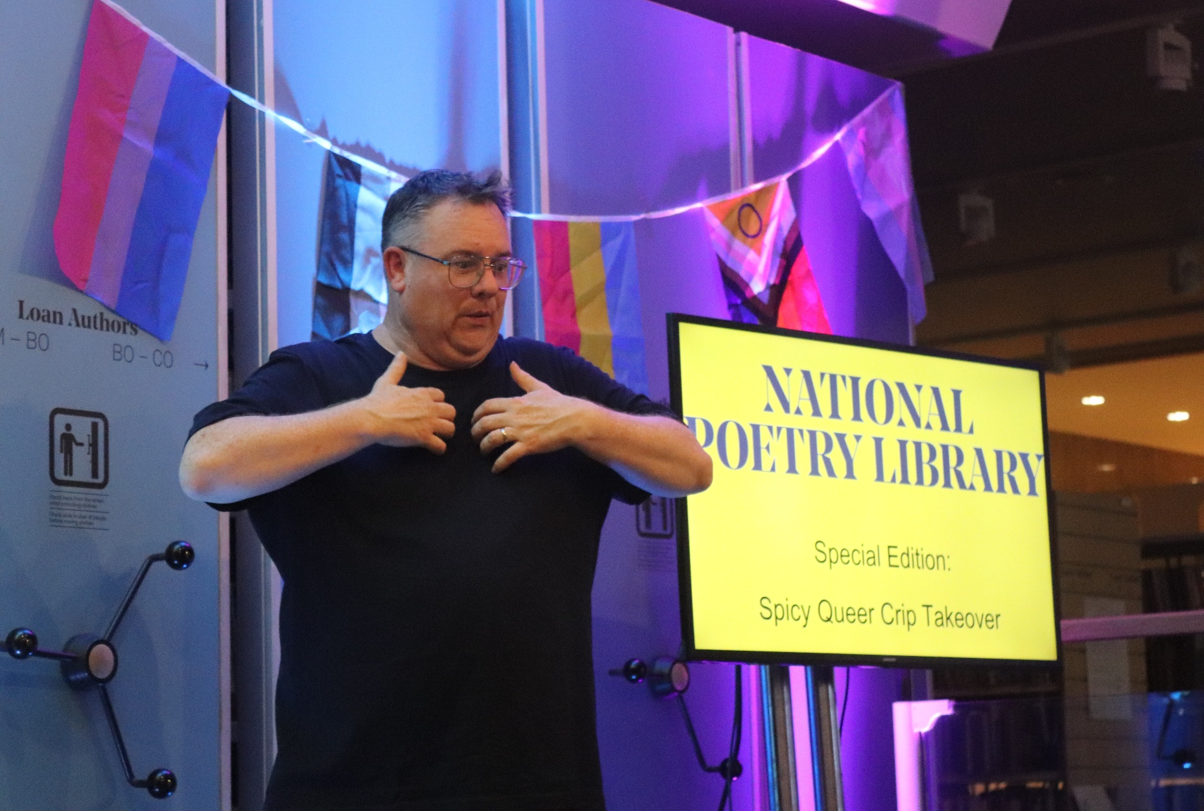
More, More, More!
More commissioning
More touring
More books
More access
More queer disabled artists platformed
More please!
”Funding structures, spaces and community are often oriented around just one element, so you're at risk of being seen as too much or losing an opportunity because you dared to complicate things by being queer, as well as disabled. Creative spaces where people can reflect their experiences with true authenticity, and with full humanity, are vital.”
Notes:
Although this is the end of the eff-able project, we hope its legacy will live on.
And that we’ve demonstrated that there’s an audience for this work, and that queer crip poetry (or any medium) about pleasure, embodiment, erotica and artistry deserve funding, publication, platforms, and permanence.
We want more. We deserve more, as a community: more commissioning, more touring, more books, more access, and more queer disabled writers and artists being effing fabulous.

Slide 12
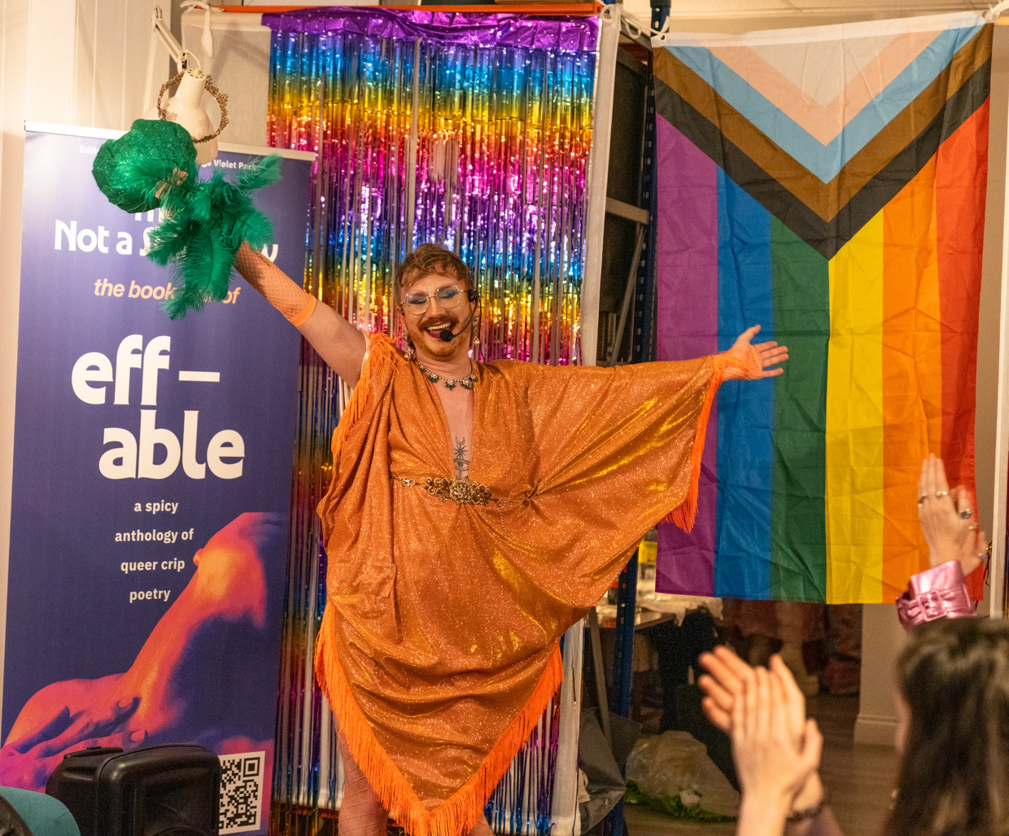
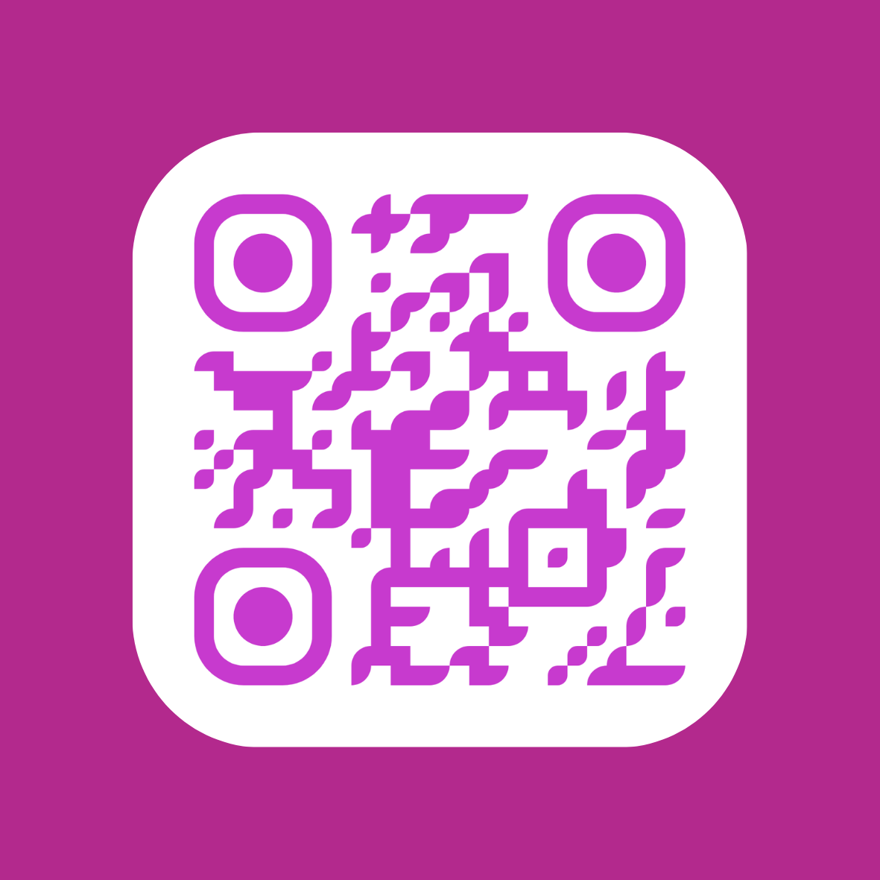
Credits
Our fabulous photographers:
James Klug
Andi Talbot
Chiara Luxardo
George & JP
https://effable.uk
“effable has helped to create spaces where everyone can be themselves unapologetically
[to] have that dialogue and create that community space”
Notes:
Finally, a shout out to our fabulous photographers, whose work you’ve seen throughout this presentation.

Slide 13
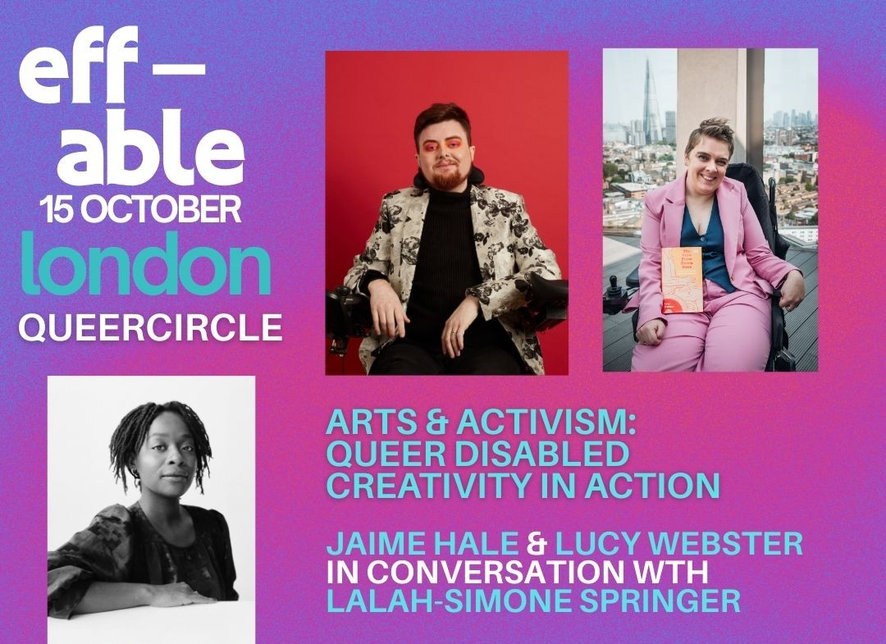
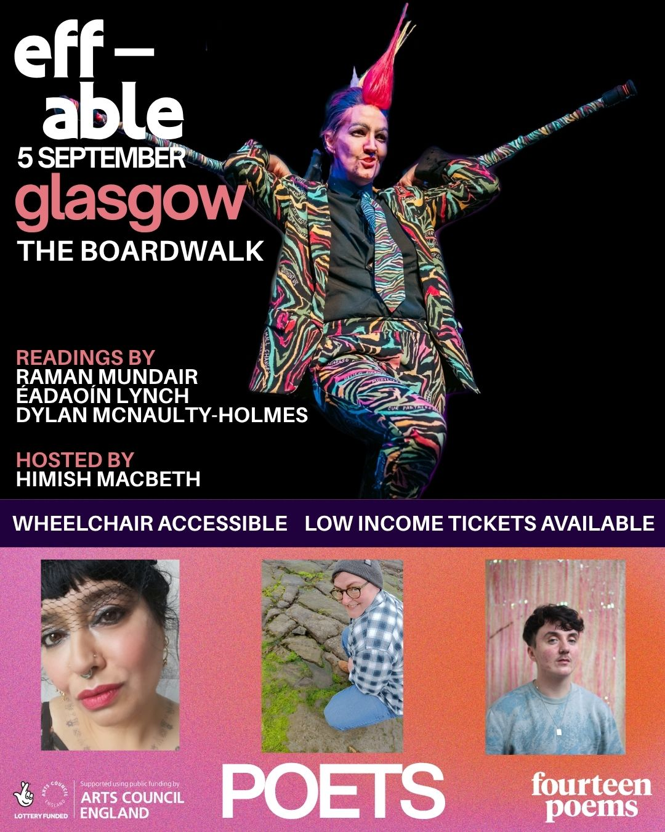
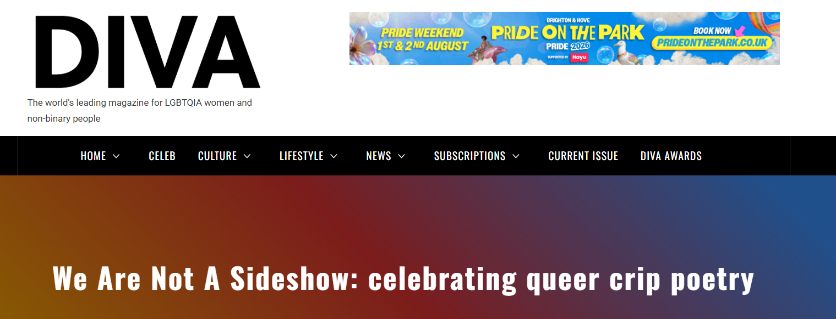
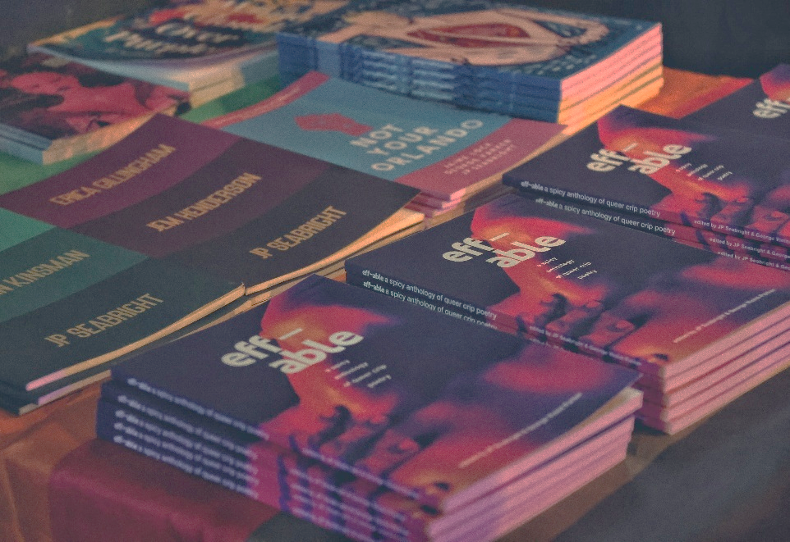
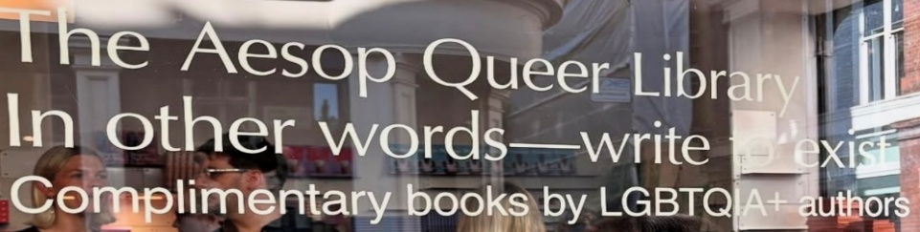

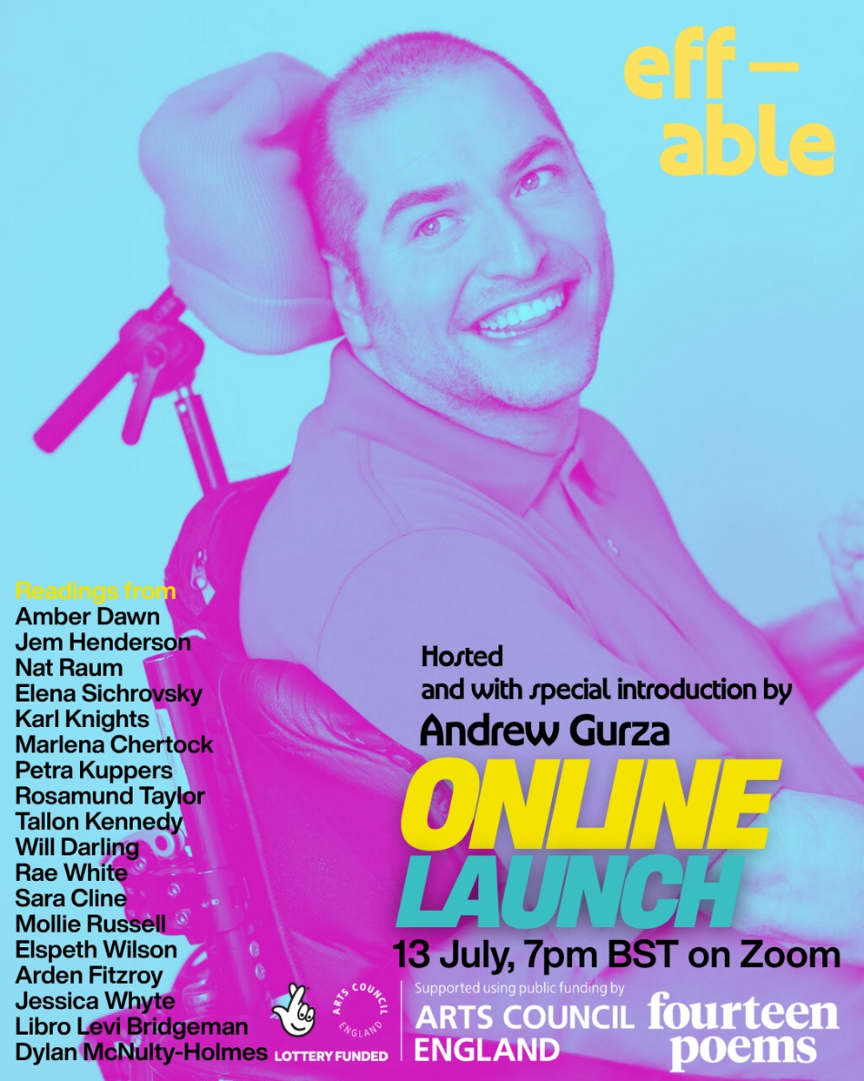
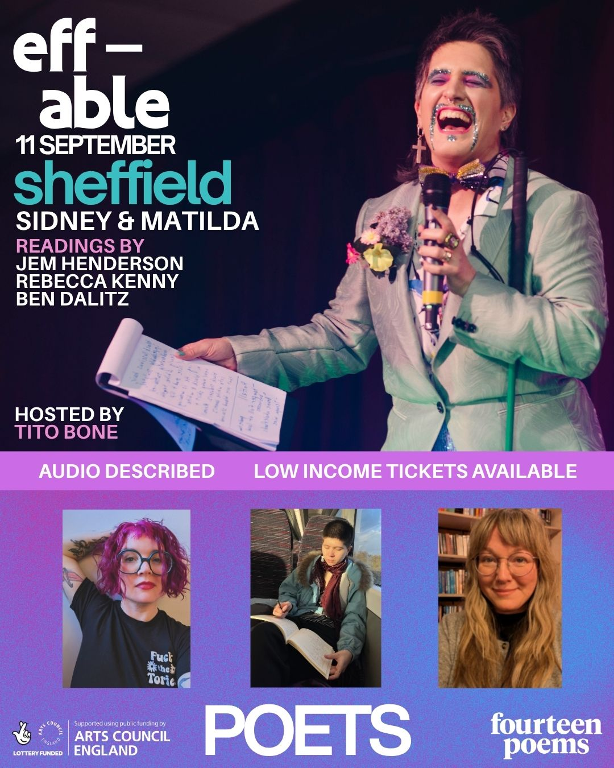

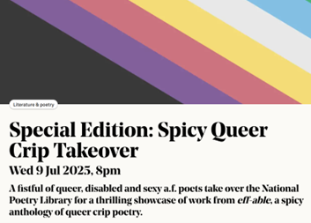
∞
Notes:
So here’s to queer crip joy!
To this effing community. To the artists. To access. To desire. To survival. To making space and taking space. To everything that made eff-able possible.
Thank you for having us.

